Slide 1
Language Processing and Compiler Construction(LPCC)
CSUA31181

Slide 2
Course Objectives: LPCC
To introduce language processing fundamentals and assemblers.
To explain design of macro processors.
To introduce compiler design process.
To explain working of syntax analyser.
To explain importance of semantic analysis and intermediate code representation
To introduce different code optimization methods

Slide 3
Course Outcomes
After completion of the course, student will be able to
1. Develop hypothetical assembler.
2. Illustrate macro processors, linkers and loaders.
3. Implement lexical analyser using LEX tool .
4. Build parser using YACC tool.
5. Construct the intermediate code representations
6. Demonstrate code optimization and code generation concept .

Slide 4
LPCC
Unit I : Introduction To Systems Programming And Assemblers
Introduction: Need of System Software, Components of System Software, Language Processing Activities, Fundamentals of Language Processing. Assemblers: Elements of Assembly Language Programming, A simple Assembly Scheme, Pass structure of Assemblers, Design of Two Pass Assembler.

Slide 5
UNIT-II
Unit II : Macroprocessors, Loaders And Linkers Macro Processor: Macro Definition and call, Macro Expansion, Nested Macro Calls and definition, Advanced Macro Facilities, Design of two-pass Macro Processor. Loaders: Loader Schemes, Compile and Go, General Loader Scheme, Absolute Loader Scheme, Subroutine Linkages, Relocation and linking concepts, Self-relocating programs, Relocating Loaders, Direct Linking Loaders, Overlay Structure. Linkers

Slide 6
Unit III:
Unit III : Introduction To Compilers Phase structure of Compiler and entire compilation process. Lexical Analyzer: The Role of the Lexical Analyzer, Input Buffering. Specification of Tokens, Recognition Tokens, Design of Lexical Analyzer using Uniform Symbol Table, Lexical Errors. LEX: LEX Specification, Generation of Lexical Analyzer by LEX

Slide 7
UNIT IV : Parsers
Role of parsers, Classification of Parsers: Top down parsers- recursive descent parser and predictive parser (LL parser), Bottom up Parsers – Shift Reduce parser, LR parser. YACC specification and Automatic construction of Parser (YACC).

Slide 8
UNIT-V Semantic Analysis
Need, Syntax Directed Translation, Syntax Directed Definitions, Translation of assignment Statements, iterative statements, Boolean expressions, conditional statements, Type Checking and Type conversion. Intermediate Code Formats: Postfix notation, Parse and syntax tress, Three address code, Quadruples and triples

Slide 9
Unit VI : Code Generation And Optimization
Code Generation: Code generation Issues. Basic blocks and flow graphs, A Simple Code Generator. Code Optimization: Machine Independent: Peephole optimizations: Common Sub-expression elimination, Removing of loop invariants, Induction variables and Reduction in strengths, Use of machine idioms, Dynamic Programming Code Generation. Machine dependent Issues: Assignment and use of registers

Slide 10
BOOKS
Text Books :
1 D. M. Dhamdhere, Systems Programming and Operating Systems, Tata McGrawHill, ISBN 13:978-0-07-463579-7, Second Revised Edition
2 Alfred V. Aho, Ravi Sethi, Jeffrey D. Ullman, Compilers Principles, Techniques and Tools, Addison Wesley, ISBN:981–235–885 - 4, Low Price Edition
3 John R. Levine, Tony Mason & Doug Brown, “Lex &Yacc”, O’Reilly
Reference Books :
1 J. J. Donovan, Systems Programming, McGraw-Hill, ISBN 13:978-0-07-460482- 3, Indian Edition

Slide 11
Introduction
What is System Software?
Is a collection of programs that bridge the gap between the level at which users wish to interact with the computer and the level at which computer is capable of operating

Slide 12
What is Software ?
Software is collection of many programs.
Two types of software:
System software-
These programs assist general use application programs.
Ex:- Compiler , Assembler etc.
Application software-
These are the software developed for the specific goal.

Slide 13
System Software
It forms a software layer which act a intermediary between the user and the computer
It is a collection of programs that facilitate execution of programs and use of resources in a computer system
Each program in the system software is called a system program
System Programming is the collection of techniques used in the design of system programs

Slide 14
Introduction
Software
Application software usually used by end-user
It is concerned with the solution of some problem, using the computer as a tool, instead of how computers actually work.
System software
System software consists of a variety of programs that support the operation of a computer (ex: text editor, compiler, debugger)
One characteristic in which most system software differ from application software is machine dependency
A system software programmer must know the target machine structure
<number>

Slide 15
System Software Concept
Users
Application Program
Debugger
Macro Processor
Text Editor
Utility Program (Library)
Complier
Assembler
Load and Linker
OS
Memory Management
Process Management
Device Management
Information Management
Bare Machine (Computer)
<number>

Slide 16
Introduction
System Software consists of a variety of programs that support the operation of a computer.
The software makes it possible for the users to focus on an application or other problem to be solved, without needing to know the details of how the machine works internally.

Slide 17
System Software and Machine Architecture
System Software vs Application
One characteristic in which most system software differs from application software is machine dependency.
System programs are intended to support the operation and use of the computer itself, rather than any particular application.
Examples of system software
Text editor, assembler, compiler, loader or linker, debugger, macro processors, operating system, database management systems, software engineering tools, …

Slide 18
Goals of System Software
User Convenience
Provide convenient method of using a computer system
Efficient Use
Ensure efficient use of computer resources

Slide 19
Fill in the Blanks
Each program in the system software is called a ____
_____facilitate execution of programs and use of resources in a computer system
Goals of system software ___, _____

Slide 20
Assembler
Assembler:-
These are the system programs which translate the assembly language program into the machine language program.
Target program /
M/C Lang. Prog.
Source program
Assembly Lang. Prog.
Assembler
Database

Slide 21
Complier
Complier:-
These are the system programs which translate the High level language program into the machine language program.
Source program
High level Lang. Prog.
Compiler
Target program /
M/C Lang. Prog.
Database

Slide 22
Cross Assembler:-
Cross Assembler:-
These are the system programs which will automatically translate the Assembly Language program compatible with M/C A, in to the machine language program compatible with M/C A, but the underlying M/C is M/C B
Target program /
M/C Lang. Prog. Compatible with M/C A
Source program
Assembly Lang. Prog. Compatible with M/C A
Cross Assembler
M/C B

Slide 23
System Software
Text editor
To create and modify the program
Compiler and assembler
Translate these programs into machine language
Loader or linker
The resulting machine program was loaded into memory and prepared for execution
Debugger
To help detect errors in the program

Slide 24
System Software and Machine Architecture
Machine dependent
Instruction Set, Instruction Format, Addressing Mode, Assembly language …
Machine independent
General design logic/strategy, Two passes assembler…
Machine independent
Machine Dependent
Computer
<number>

Slide 25
System Software and Machine Architecture
Machine dependent system software
System programs are to support the operation and use of the target computer.
The difference between different machine
Machine code
Instruction formats
Addressing mode
Registers
Machine independent system software
General design and logic is basically the same:
Code optimization
General design and logic of an assembler
<number>
Notes:
<number>

Slide 26
Programming Languages
Machine language:
It is computer’s native language having a sequence of zeroes and ones (binary). Different computers understand different sequences. Thus, hard for humans to understand: e.g.0101001...
Assembly language:
It uses mnemonics for machine language. In this each instruction
is minimal but still hard for humans to understand:
e.g. ADD AH, BL
High-level languages:
FORTRAN, Pascal, BASIC, C, C++, Java, etc. Each instruction composed of many low-level instructions, closer to English. It is easier to read and understand: e.g. hypot = sqrt(opp*opp + adj * adj);
<number>

Slide 27
Fill in the Blanks
_______ is used to create and modify the program.
________is used to detect errors in the program.
____ , computer program which translate the program from high level language to machine language.
_______, computer program which translate the program from assembly language to machine language.

Slide 28
We know…
Source Program – Assembly Language
Object Program - From assembler
- Contains translated instructions and data values from the source program
Executable Code - From Linker
Loader - Loads the executable code to the specified memory locations and code gets executed.
https://forms.gle/UzPsrjApbmVk56PF7

Slide 29
Fill in the Blanks
_____ is a program which load programs from a secondary to main memory so as to be executed
_____ is a computer program that takes one or more object files generated by a compiler and combines them into a single executable file

Slide 30
Machine and Assembly Languages
Figure : Steps in transforming an assembly language program to an executable program residing in memory.

Slide 31
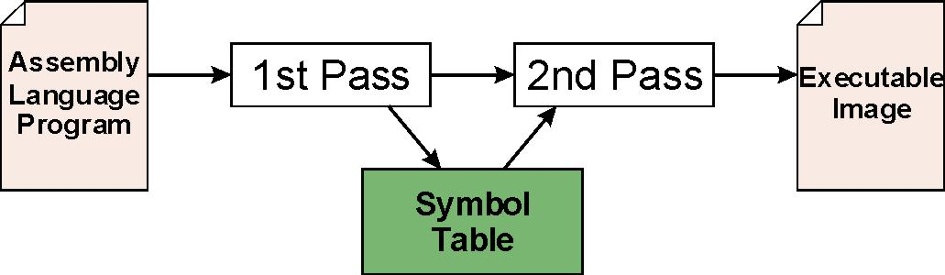
Assembly Process
Convert assembly language file (.asm) into an executable file (.obj) .
First Pass:
scan program file
find all labels and calculate the corresponding addresses; this is called the symbol table
Second Pass:
convert instructions to machine language, using information from symbol table
<number>
Notes:
<number>

Slide 32
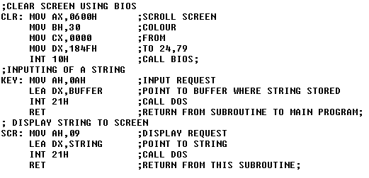
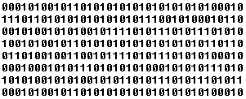
Assembly
code
Assembler
Object code
<number>

Slide 33
D. Assembler
Assembly language programming
Simple assembly scheme,
Pass structure of assembler,
Design of two pass assembler

Slide 34
Elements of assembly language programming
Mnemonic operation code (Mnemonic opcode)
Symbolic operands
Data declarations
Assembly language is a machine dependent, low level programming language which is specific to a certain computer system (or a family of computer system)
Notes:
<number>

Slide 35
Assembly Language Syntax
Each line of a program is one of the following:
an instruction
an assembler directive (or pseudo-op)
a comment
Whitespace (between symbols) and case are ignored.
Comments (beginning with “;”) are also ignored.
An instruction has the following format:
LABEL OPCODE OPERANDS ; COMMENTS
optional
mandatory
Notes:
<number>

Slide 36
Introduction-Macro Processor
Macro : a abbreviation for a group of instructions.
Acts as a preprocessor to assembler
Source prg : assembly program with macros
Target prg : assembly program without macros
Macro
processor
Source
Program
Target
program

Slide 37
Data structures
Macro Name Table (MNT)
Macro Definition Table (MDT)

Slide 38
Macro Name Table (MNT)
Name of macro | No. of parameters | Starting Index (row) | End Index (row)
SAMPLE1 | 0 | 1 | 2
SAMPLE2 | 0 | 3 | 4
SAMPLE3 | 0 | 5 | 6

Slide 39
Macro Definition Table (MDT)
1 | LOAD A
2 | ADD B
3 | LOAD X
4 | SUB Y
5 | LOAD P
6 | DIV Q

Slide 40
Modified MNT & MDT
1 | LOAD A
2 | ADD B
3 | MEND
4 | LOAD X
5 | SUB Y
6 | MEND
7 | LOAD P
8 | DIV Q
9 | MEND
Name of macro | No. of parameters | Starting Index
SAMPLE1 | 0 | 1
SAMPLE2 | 0 | 4
SAMPLE3 | 0 | 7

Slide 41
Introduction-Compiler
Translator for conversion of HLL to machine language
Source prg : High Level Language program (e.g. sample.c)
Target prg : machine language program (e.g. sample.obj)
Compiler
Source
Program
Target
program
Error Messages
<number>

Slide 42
The phases of a compiler
Source program
Lexical Analysis
Syntax Analysis
Symbol
table
manager
Semantic Analysis
Error
handler
Intermediate code generation
Code optimization
Code generation
Target program
<number>

Slide 43
Lexical Analyzer:
It combines characters in the source file, to form a "TOKEN". A token is a set of characters that does not have 'space', 'tab' and 'new line'.
It is also called "TOKENIZER"
It also removes the comments, generates symbol table and relocation table entries

Slide 44
Syntactic Analyzer:
This unit check for the syntax in the code. For ex:
{
int a; int b; int c; int d;
d = a + b - c * ;
}
This unit checks this internally by generating the parser tree

Slide 45
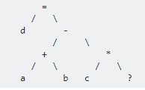
Parse Tree Therefore this unit is also called PARSER

Slide 46
Semantic Analyzer:
This unit checks the meaning in the statements. For ex
{
Int i;
Int *p;
P=i;
}
The above code generates the error “Assignment of incompatible type”

Slide 47
Code Optimization
This unit optimizes the code in following forms:
I) Dead code elimination
II) Sub code elimination
III) Loop optimization

Slide 48
Dead code elimination:
{
Int a= 10;
If(a>5)
{…..}
Else
{
}
compiler knows the value of 'a' at compile time, therefore it also knows that the if condition is always true. Hence it eliminates the else part in the code

Slide 49
Sub code elimination:
Int a, b, c;
Int x,y;
{
int a, b, c; int x, y;
/* ... */
x = a + b;
y = a + b + c;
/* ... */
}

Slide 50
{
int a, b, c;
int x, y;
/* ... */
x = a + b;
y = x + c; // a + b is replaced by x
/* ... */
}

Slide 51
Loop optimization:
For ex:
{ int a;
for (i = 0; i < 1000; i++ )
{ /* ... */
a = 10;
/* ... */
} }

Slide 52
if 'a' is local and not used in the loop, then it can be optimized as follows
{ int a;
a = 10;
for (i = 0; i < 1000; i++ )
{
/* ... */
} }

Slide 53
Code Generation
It takes the optimized representation of the intermediate code and maps it to the target machine language
It translates the intermediate code into a sequence of (generally) re-locatable machine code
Sequence of instructions of machine code performs the task as the intermediate code would do

Slide 54
Symbol Table
It is a data-structure maintained throughout all the phases of a compiler
All the identifier's names along with their types are stored here
The symbol table makes it easier for the compiler to quickly search the identifier record and retrieve it
The symbol table is also used for scope management

Slide 55
Interaction of Lexical analyzer with parser
token
Source
program
Lexical
analyzer
parser
getNexttoken()
symbol
table

Slide 56
Some terminology:
Token: a group of characters having a collective meaning. A lexeme is a particular instant of a token.
E.g. token: identifier, lexeme: pi, etc.
pattern: the rule describing how a token can be formed.
E.g: identifier: ([a-z]|[A-Z]) ([a-z]|[A-Z]|[0-9])*
Lexical analyzer does not have to be an individual phase.
But having a separate phase simplifies the design and improves the efficiency and portability.

Slide 57
Specification of tokens
In theory of compilation regular expressions are used to formalize the specification of tokens
Regular expressions are means for specifying regular languages
Example:
Letter_(letter_ | digit)*
Each regular expression is a pattern specifying the form of strings

Slide 58
Regular expressions
Ɛ is a regular expression, L(Ɛ) = {Ɛ}
If a is a symbol in ∑then a is a regular expression, L(a) = {a}
(r) | (s) is a regular expression denoting the language L(r) ∪ L(s)
(r)(s) is a regular expression denoting the language L(r)L(s)
(r)* is a regular expression denoting (L(r))*
(r) is a regular expression denting L(r)

Slide 59
Automatic construction of lexical analyzer using LEX Lex
generates C code for the lexical analyzer (scanner)
Token patterns specified by regular expressions

Slide 60
Lex
lex.yy.c
Lex Source file → Lex compiler→
C compiler→ a.out
Input stream → Scanner→ Sequence of tokens

Slide 61
Lexical Analyzer Generator - Lex
Lex Source program
lex.l
Lexical Compiler
lex.yy.c
C
compiler
lex.yy.c
a.out
a.out
Sequence of tokens
Input stream

Slide 62
Lex program structure
… definitions …
%%
… rules …
%%
… subroutines …

Slide 63
Three parts to Lex
Declarations
It has global C and Lex declaration
Regular expression definitions of tokens
%{ This is a sample Lex program written by....%}
digit --> [0-9]
number -- > {digit} +
2. Transition Rules
pattern
Regular Expression +Action when matched
{number} { printf("The number is %s\n", yytext); }
junk { printf("Junk is not a valid input!\n"); }
quit { return 0; }
3. Auxilliary Procedures
Written into the C program…..
int main() is required
%% separates the three parts
CS331 • Lexical Analysis
Notes:
<number>

Slide 64
LEX program
%{/*recognition of Verb*/%}
%%
[/t ]+ ;
is I am I are I were I was I be {printf("%s: is a verb\nn, yytext); }
[a-zA-Z]+ {printf(“%s:is not a verb\n”, yytext);}
%%
Main()
{
yylex();
}

Slide 65
Assignment 3
Write a program to implement a lexical analyzer for parts of speech.
INPUT:
Ram ran quickly
OUTPUT:
Noun: Ram
Verb: ran
Adverb: quickly

Slide 66
%{
/* Part of speech program */
%}
%%
Ram|
SAM { printf(“%s, is a Noun”,yytext); }
ran |
walk { printf(“%s, is a verb”,yytext); }
quickly |
Slowly { printf(“%s, is a adverb”,yytext); }
%%
Main()
{
yylex();
}

Slide 67
Example
% {
% }
delim [ \t\n]
ws {delim}+
letter [A-Za-z]
digit [0-9]
id {letter}({letter}|{digit})*
number {digit}+(\.{digit}+)?(E[+\-]?{digit}+)?
%%
{ws} { /* no action and no return */ }
if {return(IF);}
then {return(THEN);}
else {return(ELSE);}
{id} {yylval = install_id(); return(ID);}
{number} {yylval = install_num();return(NUMBER);}
…
%%
CS331 • Lexical Analysis
Notes:
<number>

Slide 68
Available variables
Yylval –value associated with token
yytext (null terminated string)
yyleng (length of the matching string)
yyin : the file handle
yyin = fopen(args[0], “r”)
Available functions
yylex() (the primary function generated)-starts the analysis
input() - Returns the next character from the input
int main(int argc, char *argv[])
Calls yylex to perform the lexical analysis
Int yywrap(void) wrapup, return 1 if done, 0 if not done
CS331 • Lexical Analysis
Notes:
<number>

Slide 69
Regular Expression in Lex
A- matches A
abc –matches abc
[abc]- matches a, b or c
[0-9] - matches any digit
[0-9]+ - matches any integer

Slide 70
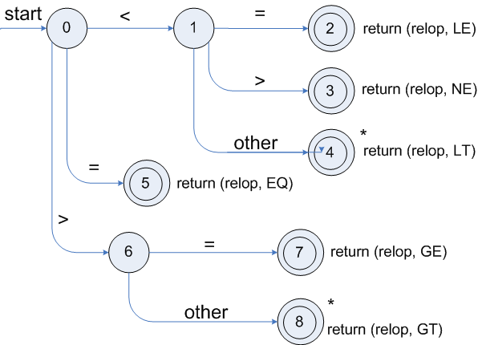
Transition diagrams
Transition diagram for relop

Slide 71
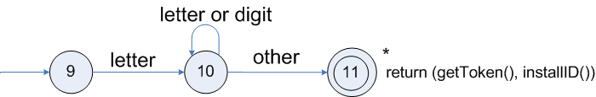
Transition diagrams (cont.)
Transition diagram for reserved words and identifiers

Slide 72
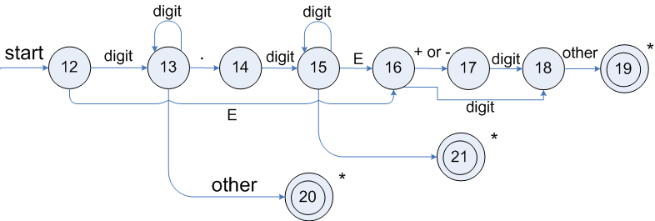
Transition diagrams (cont.)
Transition diagram for unsigned numbers

Slide 73
A. LOADERS AND LINKERS
A loader is a program which load programs from a secondary to main memory so as to be executed.
Loader is a program which accepts the object program decks, prepare these programs for execution by the computer, and initiates the execution.

Slide 74
Linker is a computer program that takes one or more object files generated by a compiler and combines them into a single executable file
Many programming languages allow you to write different pieces of code, called modules, separately.
This simplifies the programming task because you can break a large program into small, more manageable pieces.
Eventually, though, you need to put all the modules together.
This is the job of the linker

Slide 75
a linker also replaces symbolic addresses with real addresses

Slide 76
Role of a Loader
Source
Program
Assembler
Loader
Object
Program
Object program ready for execution

Slide 77
Role of a Loader and Linker
Memory
Source
Program
Assembler
Linker
Object
Program
Object program ready for execution
Executable
Code
Loader

